Slide 1
Internship Review -I : MCE434N
Xception-Powered Deep Neural Network for Radiographic Analysis
Veerasagar S S
1RV24SCS17
Centre of Competence in Visual Computing
Internal Guide Name: Dr. Soumya A Designation: Professor Organization: R. V. College Of Engineering | External Guide Name: Dr. M S Srividya Designation: Professor Organization : R. V. College Of Engineering

Slide 2
PRESENTATION CONTENTS
Introduction about the Internship
Exploration and Organizational Understanding
      Workplace Description
      Product/Service Knowledge, Organizational Concepts
Communication, Research, Teamwork, and Leadership
    Writing & Oral Communication, Research & Technology Use
    Teamwork , Leadership
Higher Order Thinking and Ethical Problem Solving
    Critical Thinking, Problem Solving
    Synthesis & Evaluation, Ethical Standards
Program-Specific Skills and Tool Application
    Technical Competency
    Knowledge Application
    Innovation & Creativity
    Relevance to Specialization
References

Slide 3
Introduction about the Internship
The program begins with foundational topics such as Python programming, emphasizing libraries like NumPy, Pandas, Matplotlib, and Seaborn for data handling and visualization.
We then explore data analytics using tools like Tableau, Power BI, and R, followed by image processing with OpenCV.
Building on these fundamentals, the next phase introduces machine learning concepts including linear and logistic regression, supervised learning algorithms like Decision Trees, KNN, and unsupervised learning through K-means clustering.

Slide 4
Introduction about the Internship
  The internship advances into neural networks and their variants (CNN, RNN), ensemble learning, and transformer models for advanced visual computing applications.
  The final modules focus on LLMs and Generative AI tools, literature exploration, algorithm selection, dataset analysis, implementation, and project presentation ensuring participants gain both theoretical understanding and practical project-based expertise in visual computing.

Slide 5
Exploration and Organizational Understanding
The Industry-Certified Internship Program at RV College of Engineering, Bengaluru emphasizes practical upskilling and career preparedness, aligning with AICTE’s mandate for experiential learning in engineering education.
Students participate in multidisciplinary, cutting-edge projects under the guidance of expert faculty mentors.
Through exposure to various Centres of Excellence and Competence, participants strengthen their technical, analytical, and research capabilities.
The program fosters hands-on learning, professional networking, and transforms students into industry-ready engineers.

Slide 6
Organizational Concepts
Python Programming and Image Processing:
            This module provides a strong foundation in Python programming, emphasizing its powerful libraries such as NumPy, Pandas, Matplotlib, and Seaborn for efficient data handling, analysis, and visualization.
            It also introduces OpenCV, a widely used computer vision library, enabling students to perform hands-on image processing tasks like filtering, edge detection, and feature extraction.
            Through practical sessions, learners gain the skills to manipulate and analyze visual data, preparing them for advanced topics in machine learning and visual computing.

Slide 7
Communication, Research, Teamwork, and Leadership
Teamwork - Collaboration and teamwork were integral to the learning experience, involving close coordination with multiple domains to design and validate model.
Critical Thinking - Applied critical thinking skills to analyze and resolve complex error within the model, ensuring accurate and precise model output.
      Problem Solving - Contributed to problem-solving initiatives by developing and implementing time-bound access roles, enabling users to obtain temporary permissions for specific tasks.
    Synthesis and Evaluation of Machine Learning Models - This stage focuses on integrating the developed machine learning models and rigorously evaluating their performance.

Slide 8
Xception-Powered Deep Neural Network for Radiographic Analysis
This project uses deep learning and transfer learning, specifically the Xception model, to automatically classify chest X-ray images into categories such as COVID-19, Normal, and Pneumonia. By leveraging advanced image-processing techniques and pre-trained neural networks, the system aims to improve diagnostic accuracy, reduce human error, and assist medical professionals in early disease detection.
Problem statement
“Develop a deep learning model using transfer learning to accurately classify COVID-19 radiography images while handling data imbalance and improving diagnostic reliability.”

Slide 9
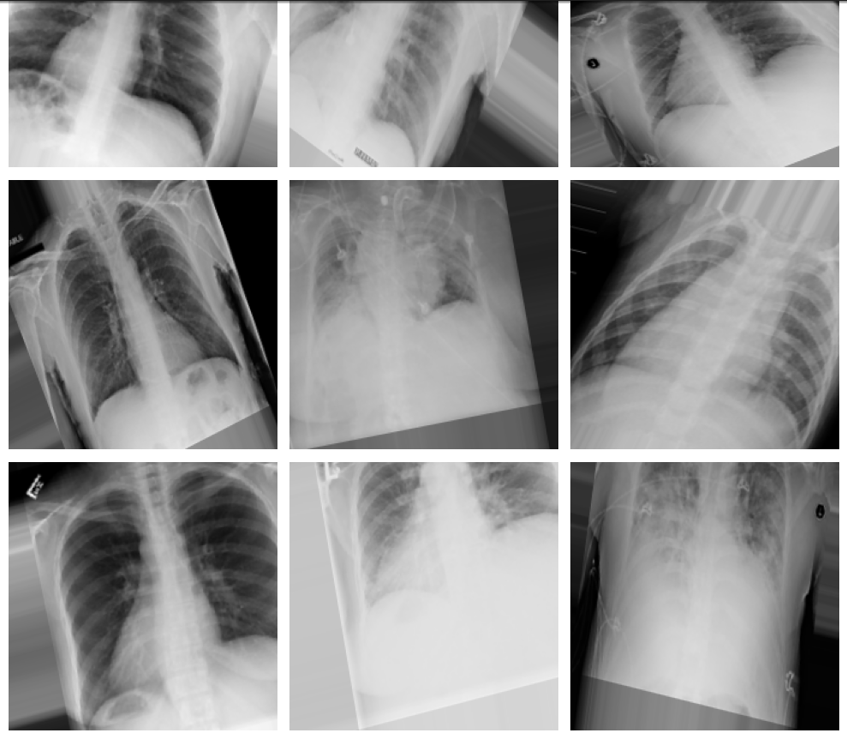
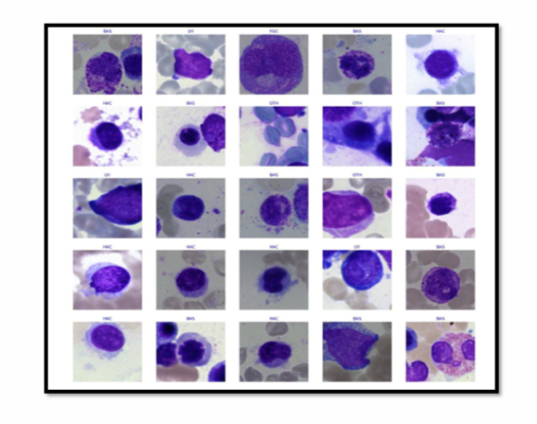
Program-Specific Skills and Tool Application

Slide 10
Motivation
Manual analysis of X-rays is time-consuming and prone to human error.
Radiologists experience fatigue → reduced accuracy
Deep learning provides:
Rapid screening
Consistent predictions
Improved sensitivity for COVID detection
    Useful in remote or resource-limited settings.

Slide 11
Datasets
https://www.kaggle.com/datasets/tawsifurrahman/covid19-radiography-database
Contains 4 classes:
COVID-19
Normal
Viral Pneumonia
Lung Opacity
    Dataset split into:
Training (70%)
Validation (20%)
Testing (10%)

Slide 12
Why Xception Model?
Uses depth wise separable convolutions → highly efficient and accurate
Performs exceptionally well on medical images
Pre-trained on millions of images (ImageNet)Reduces training time and improves generalization
Excellent at capturing:
Lung opacities
Structural patterns
Texture variations associated with COVID-19.

Slide 13
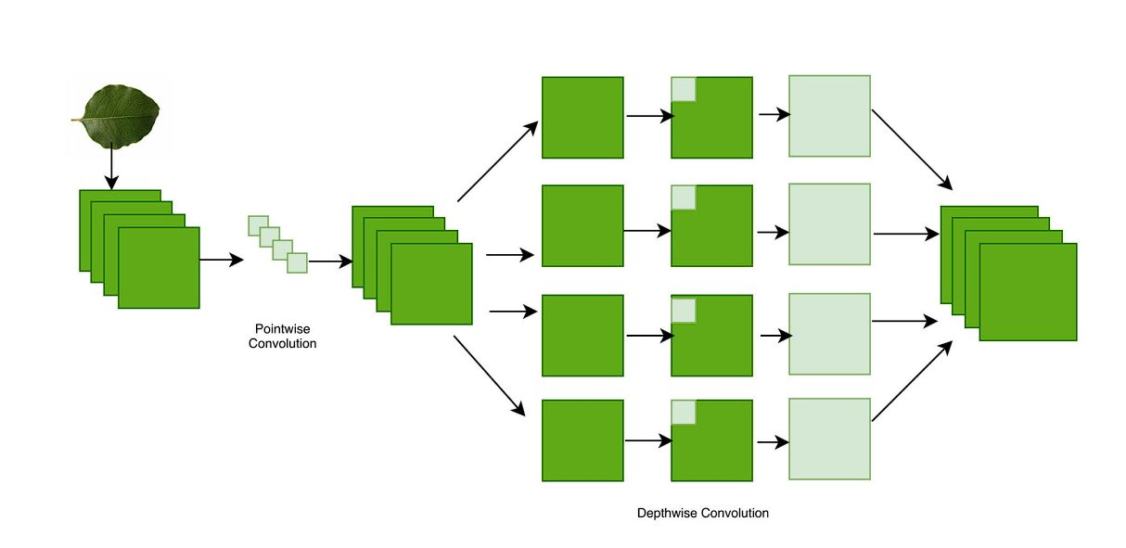
Why Xception Model?

Slide 14
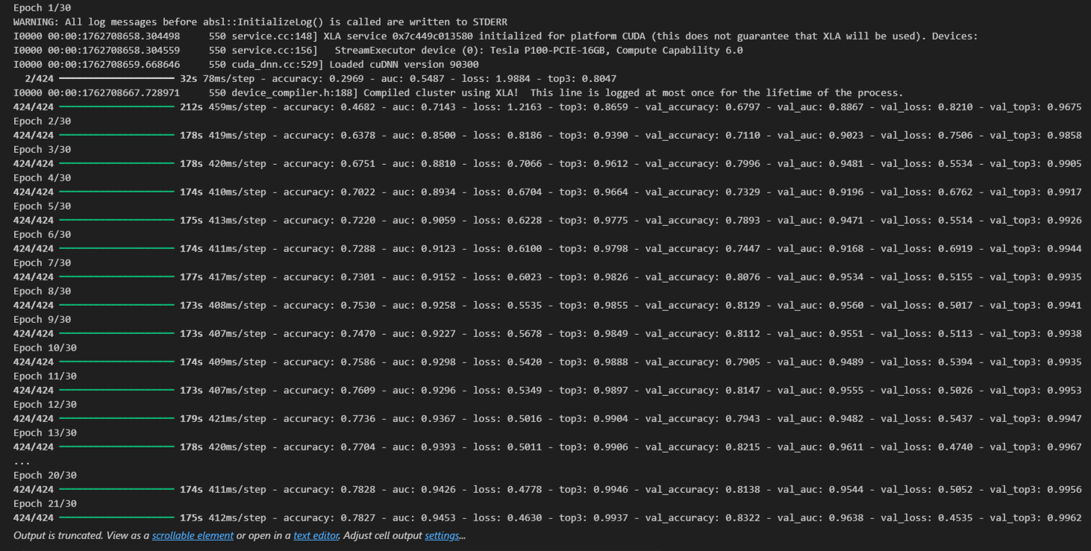
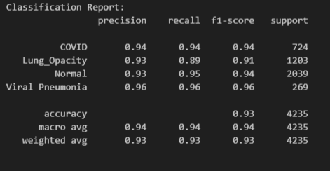
Results

Slide 15
Conclusion
The project demonstrates that deep learning can effectively classify chest X-ray images for COVID-19 diagnosis
The Xception-based transfer learning model achieved high accuracy and strong generalization across multiple radiographic classes.
The system provides a fast, reliable, and scalable tool to support radiologists in early COVID-19 detection
Automated classification reduces manual workload and minimizes human error in radiographic interpretation
The project highlights the potential of AI-driven solutions to improve medical diagnostics, especially during large-scale outbreaks.

Slide 16
REFERENCES (As per IEEE format and must be Numbered
consecutively in order of first mention) & Annexures / Appendix
T. Rahman et al., “COVID-19 Radiography Database,” Kaggle, 2020. [Online]. Available: https://www.kaggle.com/datasets/tawsifurrahman/covid19-radiography-database
F. Chollet, “Xception: Deep Learning with Depthwise Separable Convolutions,” in Proc. IEEE Conf. Comput. Vis. Pattern Recognit. (CVPR), 2017, pp. 1251–1258.
A. Krizhevsky, I. Sutskever, and G. E. Hinton, “ImageNet Classification with Deep Convolutional Neural Networks,” Commun. ACM, vol. 60, no. 6, pp. 84–90, 2017.
S. Minaee et al., “Deep-COVID: Predicting COVID-19 from Chest X-Ray Images Using Deep Transfer Learning,” Med. Image Anal., vol. 65, p. 101794, 2020.
L. Wang, Z. Q. Lin, and A. Wong, “COVID-Net: A Tailored Deep Convolutional Neural Network Design for Detection of COVID-19 Cases from Chest X-ray Images,” Sci. Rep., vol. 10, pp. 1–12, Aug. 2020.
P. K. Sethy and S. K. Behera, “Detection of Coronavirus Disease (COVID-19) Based on Deep Features,” Preprint, Mar. 2020. [Online]. Available: https://doi.org/10.13140/RG.2.2.21946.93125

